Slide 1




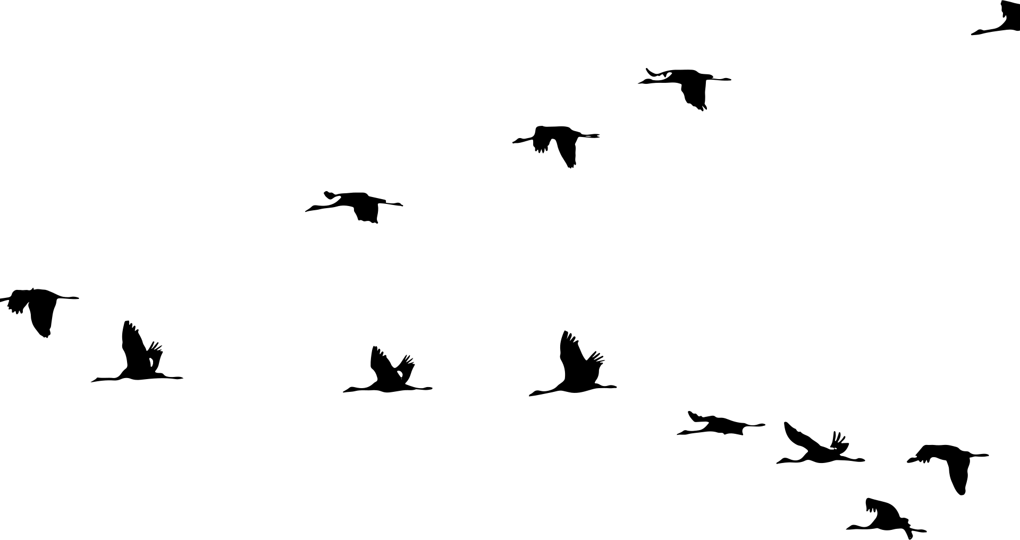
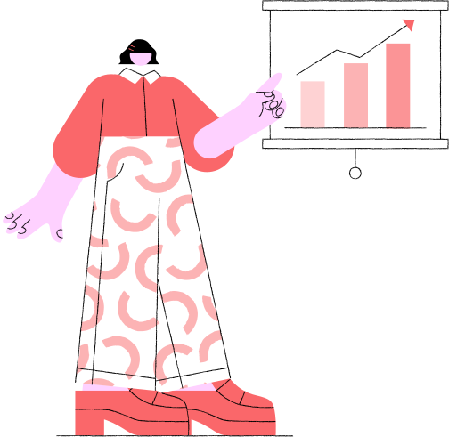

CSE271 - Data Science Methodology
Mobile Usage Impacts
Presentation by
Jana Sherif 22-101234
Rokaya Radwan 22-101171

Slide 2
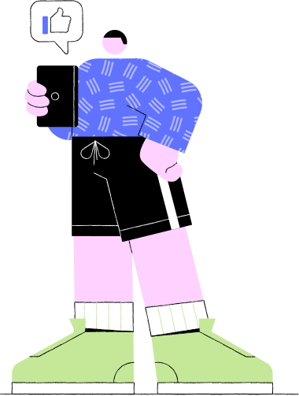



Introduction
This project explores the relationship between smartphone usage patterns and indicators of addiction and stress among users. We applied both regression and classification models to analyze how features such as screen time, notifications, and night usage influence user well-being.

Slide 3

Data Preprocessing
All features were checked for missing values. None were found.
The addiction_status field was converted into binary values instead of string values.
The stress_risk was calculated into binary values instead of continuous values.
Explanatory variables were scaled using StandardScaler() to prepare for models sensitive to feature magnitude.
Data was split into 80% Training and 20% testing ratios.

Slide 4

Regression
Target Variable: Stress Level
Chosen Features: Daily Screen Time and Night Usage
Feature Selection: Correlation Heatmap, Scatter Plots
Classification
Target Variable 1: Addiction Status
Target Variable 2: Stress Risk
Chosen Features: Daily Screen Time, night usage, app sessions, notifications and age
Feature Selection: Correlation Heatmap
Feature Selection and Data Exploration

Slide 5


Regression
Models
Multiple Linear Regression:
LinearRegression()
Lasso Regression
Lasso(alpha=0.1)
Polynomial Regression
PolynomialFeatures(degree=2)
Random Forest Regression
RandomForestRegressor(n_estimators=100, random_state=42)

Slide 6
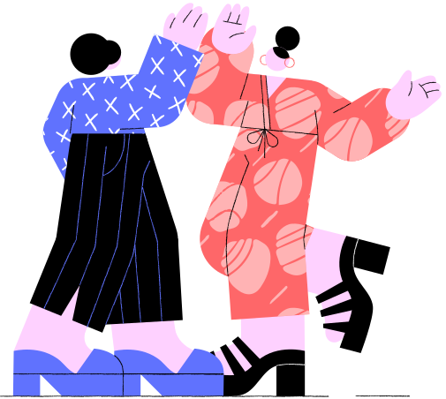

Coefficient values were calculated for the linear, lasso, and polynomial models
Feature importance was calculated for the Random Forest model
Both were shown in bar plots for comparison
r², RMSE, and MSE were calculated for all models
For the polynomial model, metrics were calculated on both training and testing to spot over-fitting
Prediction vs. Actual values, scatter plots for each model
Residual Plots for each model
Regression Models Evaluation

Slide 7
Classification Models
Logistic Regression
a parametric, model-based, supervised learning algorithm. It was selected for its simplicity and interpretability in binary classification.
K-Nearest Neighbors
a non-parametric, instance-based, supervised learning algorithm. It was selected for its flexibility and ability to catch non-linear patterns.
They were chosen together to provide variety and contrast in modeling approaches.

Slide 8

Classification Models Evaluation
Each model was assessed using appropriate evaluation metrics:
Accuracy, Precision, Recall, F1-Score, and ROC Curves. Confusion matrices were also presented.
 | Not Addicted | Addicted
 | 1306 | 30
 | 24 | 1358
 | Low Risk | High Risk
 | 1306 | 30
 | 24 | 1358
Logistic Regression:
K-Nearest Neighbors:
Actual
Actual
Not Addicted
Low Risk
Predicted
Predicted
Addicted
High Risk
Accuracy: 0.9801324503311258
Precision: 0.978386167146974
Recall: 0.9826338639652678
F1 Score: 0.9805054151624548
Accuracy: 0.9705665930831494
Precision: 0.9425414364640884
Recall: 0.9682179341657208
F1 Score: 0.9552071668533034

Slide 9
Thank you
Use Your Mobile Carefully <3

